Slide 1
The Champions
International Week of the Deaf 2021

Slide 2
OtoQuiz 2021 Winners!
First Place - Shika Pradej & Reshma G.
Second Place - Ritajit Biswas & Pratik Patil
Third Place - Rajdeep Chaudhary & Shakib Sheikh

Slide 3
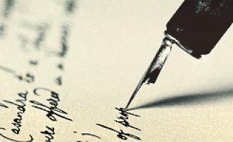
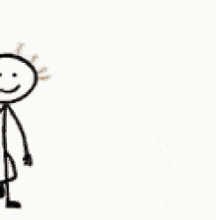
Short Story Writing Competition
First Place Dr. Khavya AR , Dr.Abdul Azeez
Second Place Dr. Rajdeep Choudhary
Third Place Dr.Eshwar Karthikeyan, Dr.Marudu Raj

Slide 4
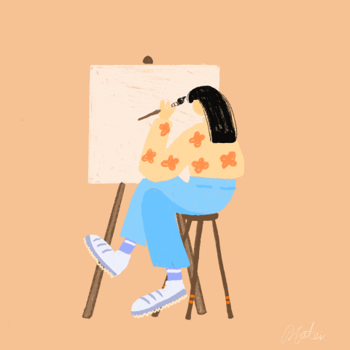
Poster Competition
First Place – Aiza Samhitha & Kamatham Divija
Second Place – Aarti Pal & Kavi
Third Place – Deveshi Bhatnagar & Vijaya Chaubey
- Tamanna & Sumana

